Slide 1
CMSC204
Kartchner
V(StateGraph) = {Oregon, Alaska, Texas, Hawaii, Vermont, NewYork, California}
E(StateGraph) = {(Alaska, Oregon), (Hawaii, Alaska), (Hawaii, Texas), (Texas, Hawaii), (Hawaii, California), (Hawaii, New York), (Texas, Vermont), (Vermont, California), (Vermont, Alaska)}
1. Draw the StateGraph
O
V
T
C
N
A
H

Slide 2

a. Show the adjacency matrix that would describe the edges in the graph. Store the vertices in alphabetical order
States
3. b. Show the adjacency lists
that would describe the edges in the graph

Slide 3
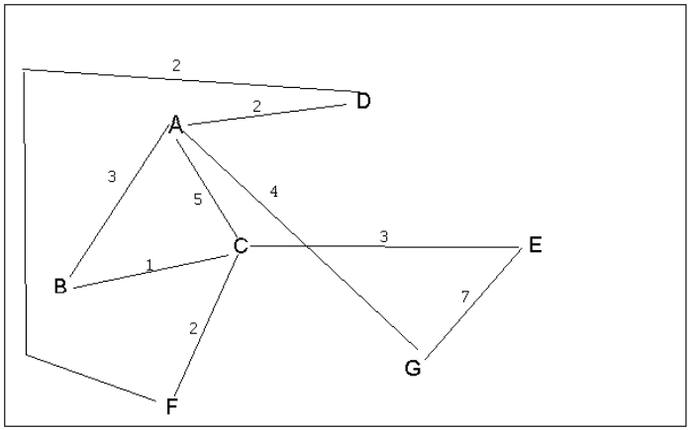
4 a. Which of the following lists the graph nodes in depth first order beginning with E?
A) E, G, F, C, D, B, A
B) G, A, E, C, B, F, D
C) E, G, A, D, F, C, B
D) E, C, F, B, A, D, G
C is correct
4 b. Which of the following lists the graph nodes in breadth first order beginning at F?
A) F, C, D, A, B, E, G
B) F, D, C, A, B, C, G
C) F, C, D, B, G, A, E
D) a, b, and c are all breadth first traversals
A is correct

Slide 4
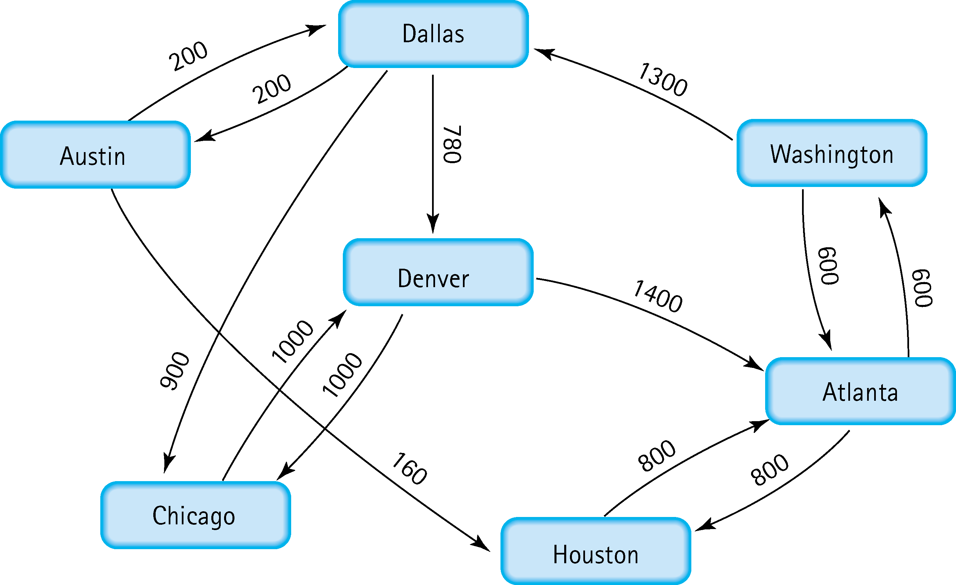
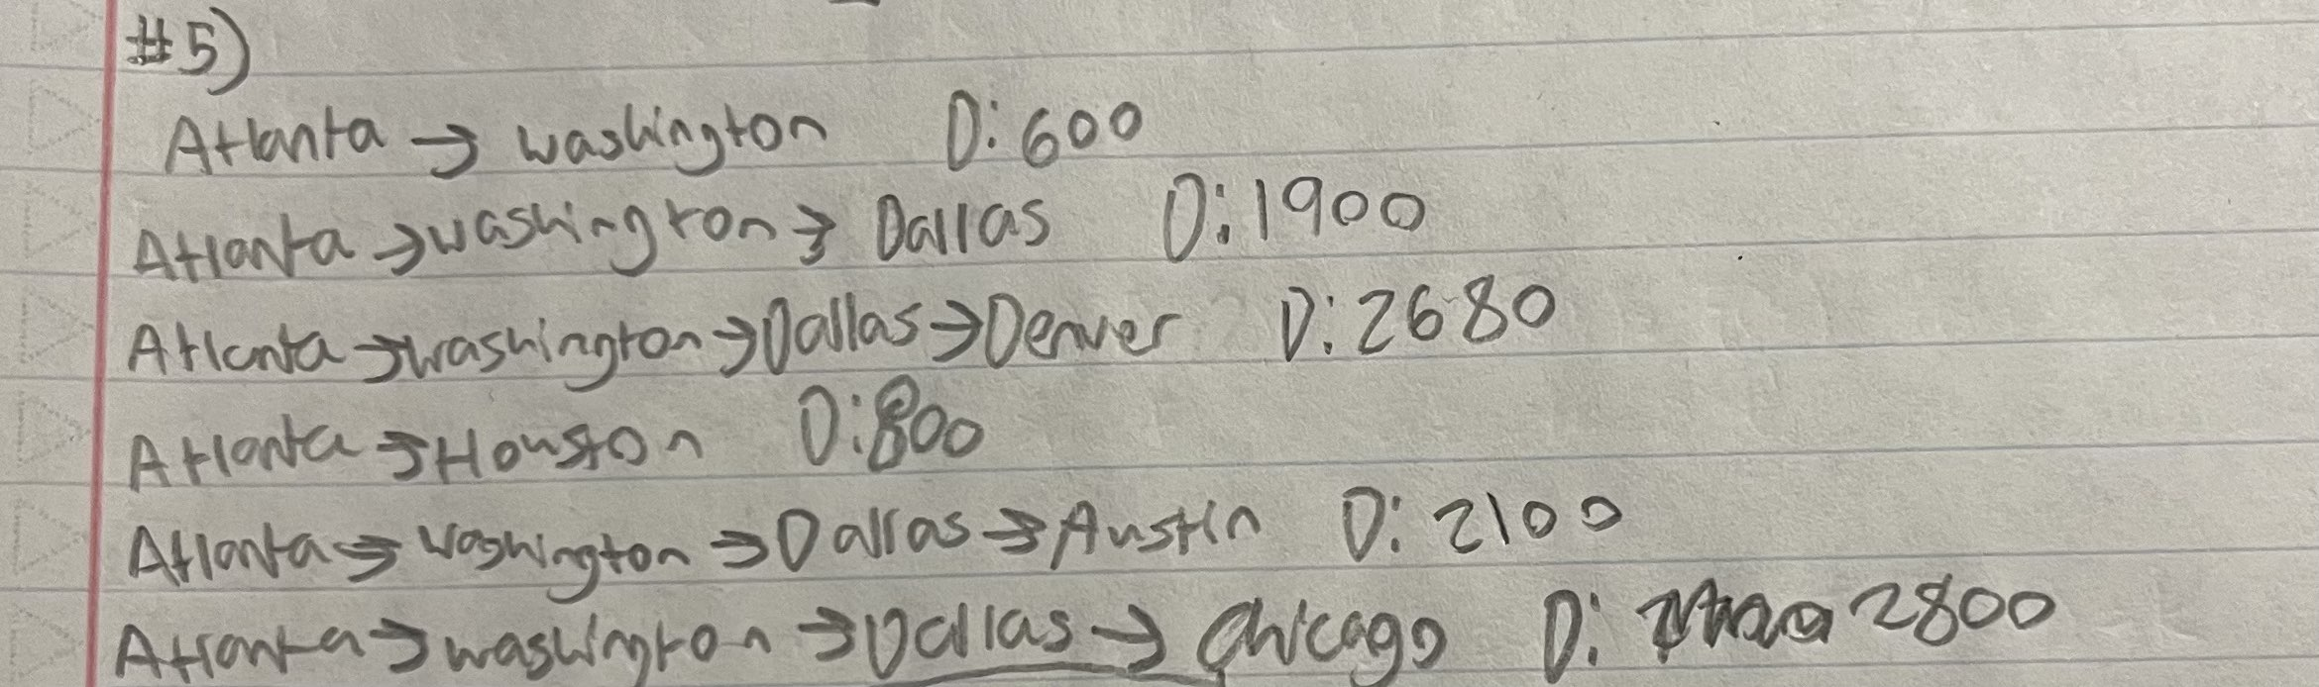
5. Find the shortest distance from Atlanta to every other city

Slide 5
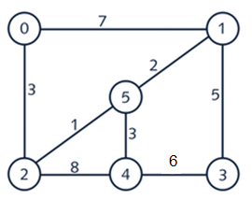
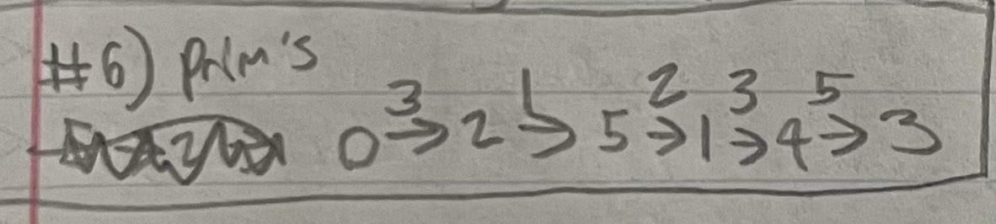
6. Find the minimal spanning tree using Prim’s algorithm. Use
0 as the source vertex . Show the steps.

Slide 6
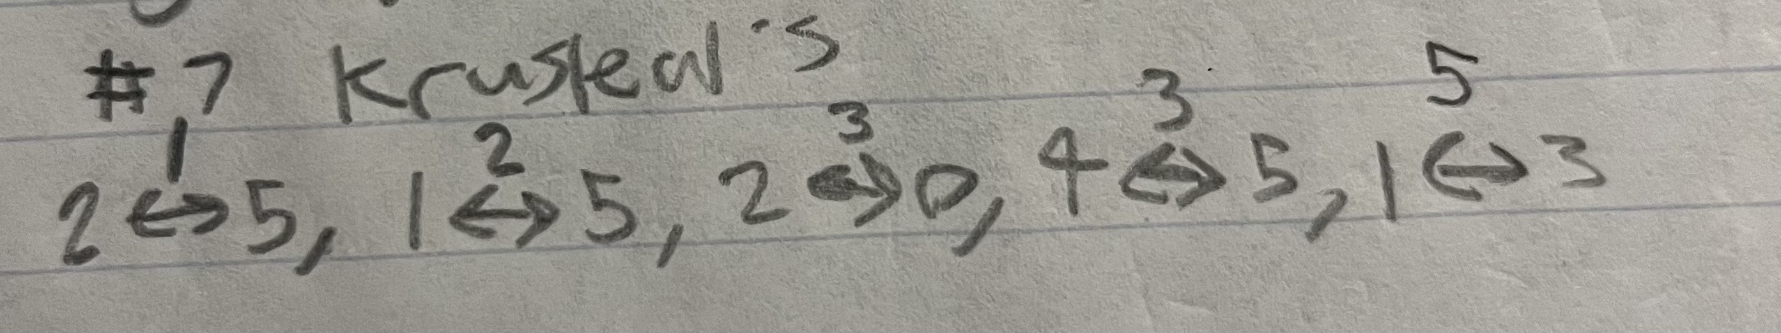
7. Find the minimal spanning tree using Kruskal’s algorithm.
Show the weights in order and the steps.

Slide 7
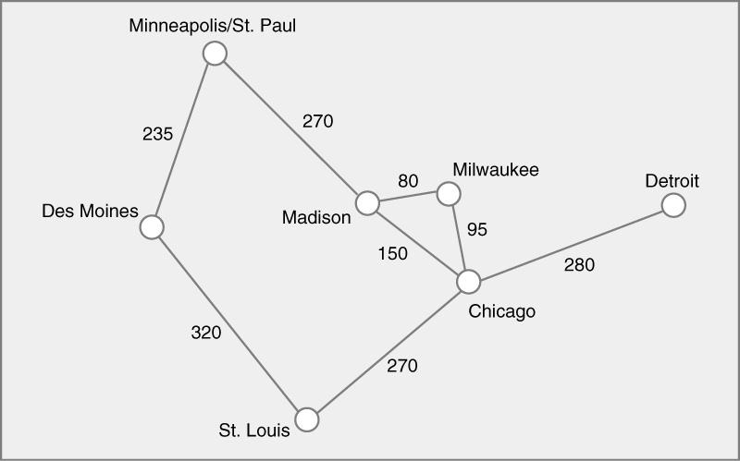
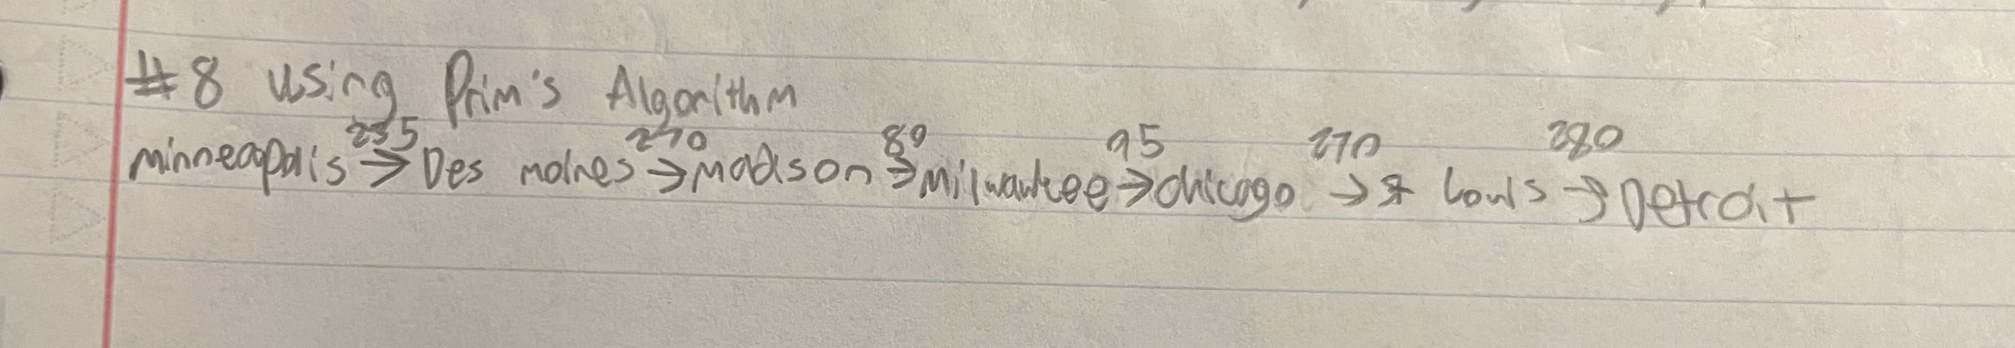
8. Find the minimal spanning tree using the algorithm you prefer. Use
Minneapolis/St. Paul as the source vertex

Slide 8
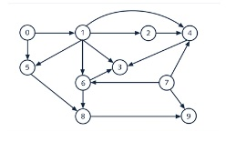

9. List the nodes of the graph in a breadth first topological ordering. Show the
steps using arrays predCount, topologicalOrder and a queue

Slide 9

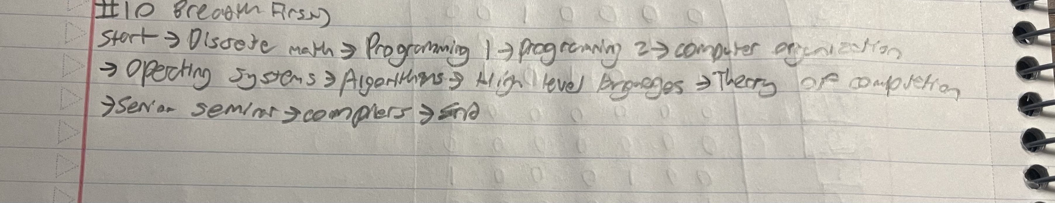
10. List the nodes of the graph in a breadth first topological ordering.

